Slide 1
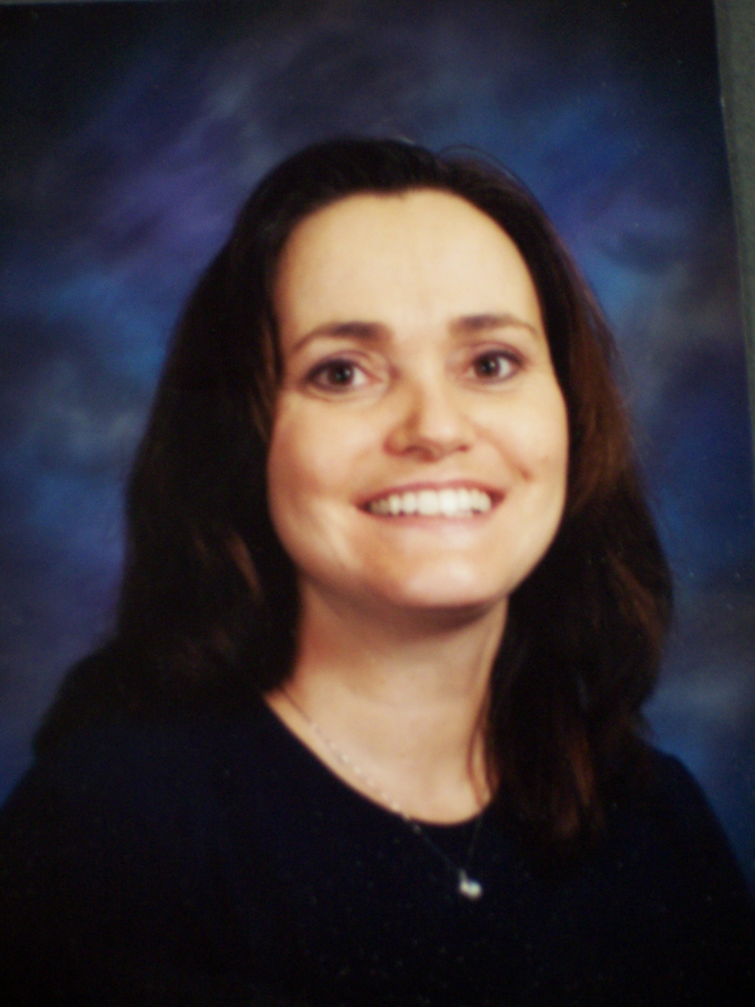

Mrs. Rediger

Slide 2
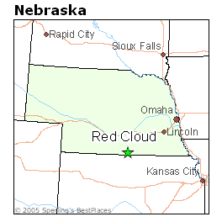
Where were you born??

Slide 3
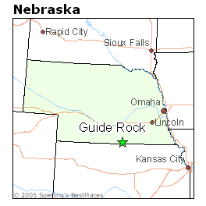
Where did you grow up?

Slide 4
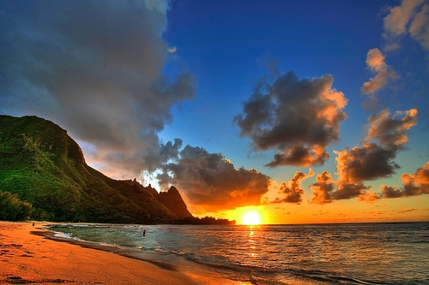
If you could go anywhere in the world, where would you go?
Why?
Hawaii
I would love to take a cruise around the islands. I enjoy the warm weather.

Slide 5
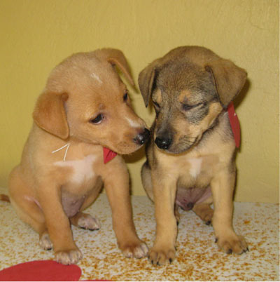


Do you have pets? Names
Skittles
Tilly

Slide 6

What is your favorite pastime?
Spending time with family.

Slide 7

What is your favorite quote/bible verse?
Proverbs 3: 5-6
Trust in the Lord with all your heart, and lean not on your own understanding;
In all your ways acknowledge Him,
And He shall direct your paths.

Slide 8
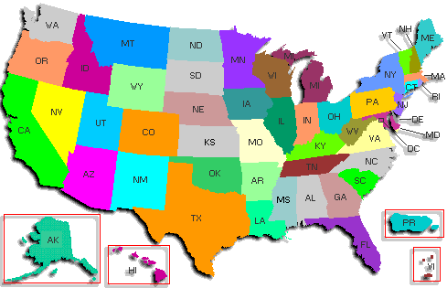
Where all have you lived?
Guide Rock, NE
Springview, NE
Winner, SD
Albany, OR
Hastings, NE
Hyannis, NE

Slide 9

How did you find this job?
Newspaper

Slide 10

Do you enjoy coaching?
I enjoy most sports. Volleyball has always been one of my favorites. Coaching allows me to take part in something that I once enjoyed playing myself.

Slide 11

How many children do you have?
Two Daughters
  Shea Rediger-17
  Sierra Rediger-13

Slide 12
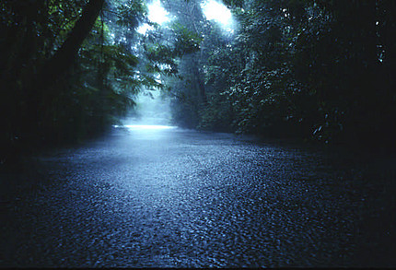

Playing softball with my family during a rainstorm.
What is your favorite childhood memory?

Slide 13
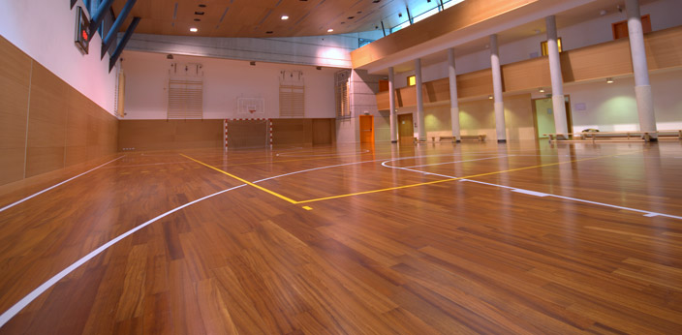


What are your favorite sports?
Volleyball
Basketball

Slide 14

What is your favorite color?
BLUE!!!!

Slide 15

CREDITS
Producers
Jessie Schwanebeck
Alisha Conner
Music
Alan Jackson-Remember When
(Favorite song)

